Slide 1
SSW-810: Software Engineering Tools and Techniques
Refactoring,
Configuration Management with Git and GitHub
Dr. Raz Saremi
Software Engineering
School of Systems and Enterprises
This Lecture is based on material from Prof. Jim Rowland

Slide 2

Acknowledgements
This lecture includes material from
Refactoring: Improving the Design of Existing Code by Martin Fowler
Pro Git : Chacon and Straub
https://progit2.s3.amazonaws.com/en/2016-03-22-f3531/progit-en.1084.pdf
Getting started with GitHub
https://guides.github.com/activities/hello-world/
https://guides.github.com/
https://www.git-tower.com/learn/

Slide 3

Overview
We don’t always get software right the first time
Bad smells
Technical debt
Refactoring
Why manage file versions?
What is Configuration Management?
Tools for Configuration Management
Git
GitHub

Slide 4

Software evolution
We don’t always (rarely) get software right the first time
Writing the code helps to identify improvements
Respond to changes in requirements, architecture and design
Some Agile Methods (XP) emphasize providing the simplest solution that meets all requirements, but may require later changes
How to optimize code readability and maintainability without losing functionality and reliability?

Slide 5
What is refactoring?
Refactoring: changing the internal structure of software to make it easier to understand and cheaper to modify without changing its observable behavior
http://www.moniro.com/my_pictures/product-software-refactoring.png

Slide 6
What is refactoring?
Refactoring (noun): a change made to the internal structure of software to make it easier to understand and cheaper to modify without changing its observable behavior
Refactoring is not about performance optimization
A user should not be able to tell that the code has been refactored
A code refactoring makes the code easier to understand and maintain
Improve readability and reduce complexity
Refactoring is critical for code that changes frequently

Slide 7
Why refactor?
We start with a good design and write good code to implement that design
BUT, over time the code changes to meet changes in the requirements
BUT, the design may not be updated to optimize those changes
Refactoring refreshes the design and the code to reflect an optimal solution for our latest understanding of the problem and solution

Slide 8
Technical debt
Additional development, testing, and maintenance effort
Caused by
Bad design
Taking shortcuts, and
Not implementing the “right” solution throughout the lifecycle
Quick hacks add technical debt
Technical debt accumulates “interest” and makes changes even harder later on
Refactoring helps to pay off "technical debt"

Slide 9
Good automated test cases are critical
Refactoring replaces working code with new code
Research shows that new code is more likely to contain bugs than older code
Automated regression testing is critical
Regression testing verifies:
The new code replicates the behavior of the old code
The new code doesn’t add any new bugs
Automated test tools, e.g. unittest, are critical

Slide 10
When to refactor?
Rule of three
First time, just do it
Second time, wince at duplication
Third time refactor
When you add functionality
When you need to fix a bug
As you do a code review

Slide 11

But closely related…
But closely related…

Slide 12

How to track changes?
You’ve changed your code
Refactoring improvements
Adding new features
What to do with earlier versions of files?
Replace them with new versions?
Rename file.py to ofile.py to reallyOldFile.py?
How many changes can you track in your head?

Slide 13
Tracking a file without tools
What changed?
foo.py
ofoo.py
ofoo2.py
That change didn’t work…
Where’s the old version?
ofoo.py.old
ofoo.py.27
foo.py

Slide 14

What problem are we trying to solve?
You’ve started working on a project…
By yourself
At school with 2 other students
At a small start up company with 5 developers
At a large company with 5000 developers
How are you going to manage changes (new code and updates)?
What changed in this file?
Who made the change?
Why was the change made?
Where’s the version that used to work?

Slide 15

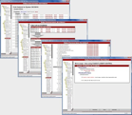
What problem are we trying to solve?
One developer tracking changes to local files
How to manage the changes and configurations?

Slide 16
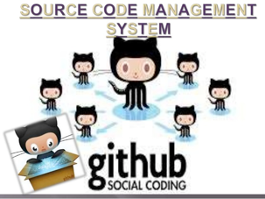

What problem are we trying to solve?
Many developers contributing and changing shared files for a common product
How to manage the changes and configurations?

Slide 17
What is configuration management?
SWEBOK (Software Engineering Body of Knowledge)
www.swebok.org defines CM:
“Configuration management (CM)… is the discipline of
identifying the configuration of a system at distinct points in time for the purpose of systematically controlling changes to the configuration,
maintaining the integrity and traceability of the configuration throughout the system life cycle.
The tools and processes that control and manage the artifacts and configurations of the system”

Slide 18







Many solutions
The default for Open Source projects

Slide 19
Benefits of Configuration Management
Easy access to current and previous versions of files
Compare file versions: what changed?
Revert to earlier versions of a file
Facilitate collaboration across team
Support many developers working on the same files
Create branches to explore new features
Automatically merge multiple changes
Files can be backed up in multiple places

Slide 20
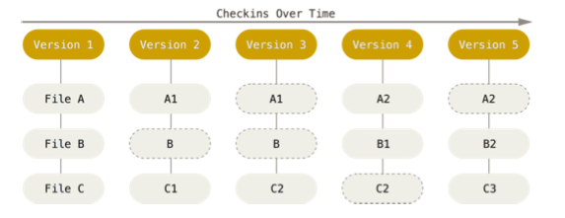
Git concepts
Git maintains a stream of snapshots of the system
Tracks changes by many contributors
Allows you to recreate the system at any earlier version
File A changed
File A1 unchanged
Source: https://progit2.s3.amazonaws.com/en/2016-03-22-f3531/progit-en.1084.pdf

Slide 21
Git Concepts
Repository
Files are stored in a repository
Developers add features or fix bugs in a Local repository
Local copy of the repository
Files are merged and shared in Remote, shared repository
Shared server, e.g. github.com
Branch
A branch isolates changes in a specific context
Create new features, do bug fixes, experiment, …
e.g. Master branch may represent the current product
Dev branch may represent change for a group of features

Slide 22
Git Concepts
Commits
A unit of work, i.e. a collection of related changes, written to the repository
New feature, bug fix, …
May involve one or more files, but should represent a logical unit of functionality
Changes should committed frequently to a branch, but only when the feature is complete

Slide 23
Git Concepts
Fetch/Push/Pull/Merge
Developers typically make changes to the local repository
We need to sync the multiple local repositories back into a branch in the the common, remote repository
Fetch retrieves the latest structure from the remote repository, including all commits and latest changes
Push pushes the local changes up to the remote repository and merges the changes from all contributors
Pull pulls down changes from the remote repository and merges the changes into the local repository
Merge combines changes within or across branches

Slide 24
Git Concepts
Project Repository
Master Branch
Dev Branch
Amit’s Commits
Maha’s Commits
Fei’s Commits
file0.py updates
file1.py updates
file2.py updates
file2.py updates
file0.py updates
Version 1.0 Branch

Slide 25
Simplified Workflow
Remote Repository
* Push and Pull merge changes across files
Developer Environment
Clone Existing Repository
Create new
Branch
Pull* changes from remote repository
New features / bug fixes
Commit change to local repository
Push* changes to remote repository
Create new
Repository

Slide 26
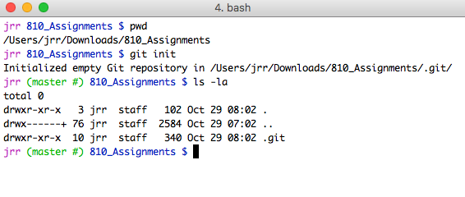
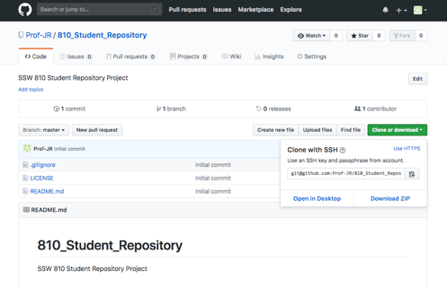
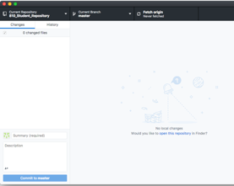
3 ways to interface with Git
Command Line
All Git commands are available from the command line
http://github.com
Manage your project from the GitHub website
GitHub Desktop Client, etc.
Several desktop clients are available
Simplifies common Git commands

Slide 27
Let’s try it…
Walk through a common scenario…
Create a remote repository for a new project on github.com
Clone the remote repository to a local repository
Create a new ‘dev’ branch
Create a new file in the local repository
Commit changes locally
Push changes to the remote repository
Change the file in the remote repository
Pull the changes from the remote repository
Merge ‘dev’ and ‘master’ branch

Slide 28
Creating a Repository: new or clone
Create repository
Create a new repository for a new project
Create a local or remote repository
http://github.com – most repositories are public to all
Shared server (private or cloud)
Remote repository provides back up
Clone an existing repository
Local copy of the structure of the remote repository
Pull changes from the remote repository to local
Push local changes to the remote repository
Ideal for team projects
Unusual, except for new projects
More common when joining an existing project

Slide 29
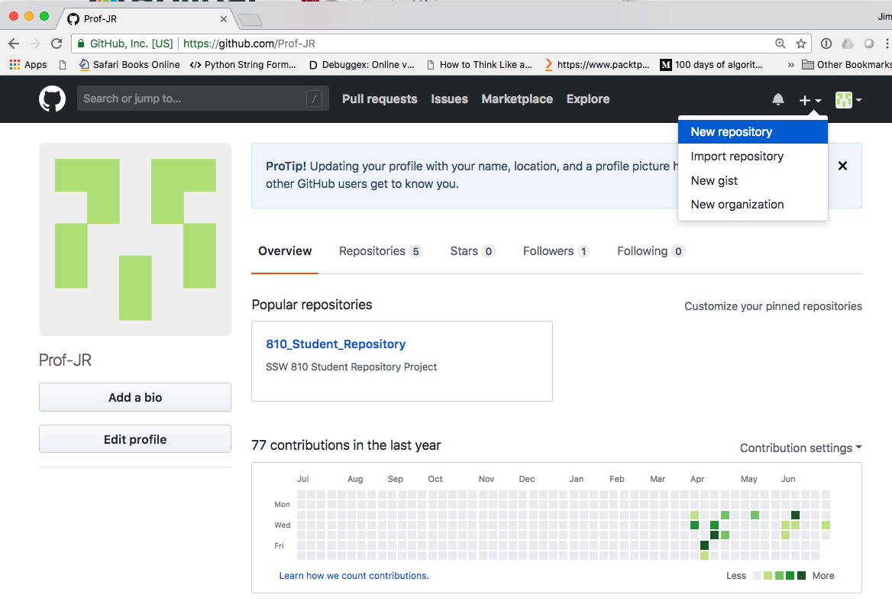
Create a new GitHub Repository
Create a free GitHub login
Create a new repository

Slide 30
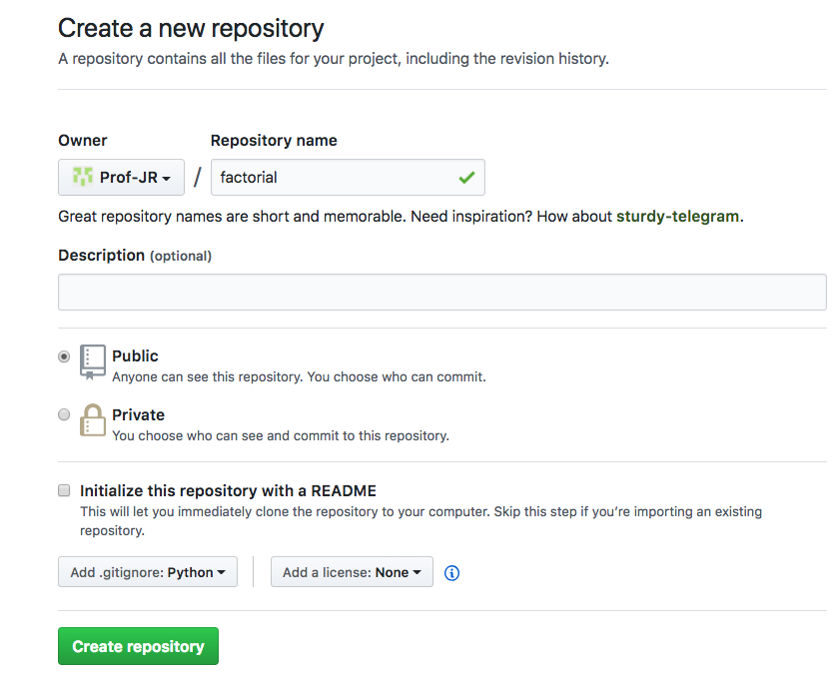
Create a new GitHub Repository
Public Repositories
Visible to everyone
Great for open source projects
Free of charge
Private repositories are visible only by invitation
Requires paid account
.gitignore tells Git to ignore generated files, e.g. .DS_Store

Slide 31
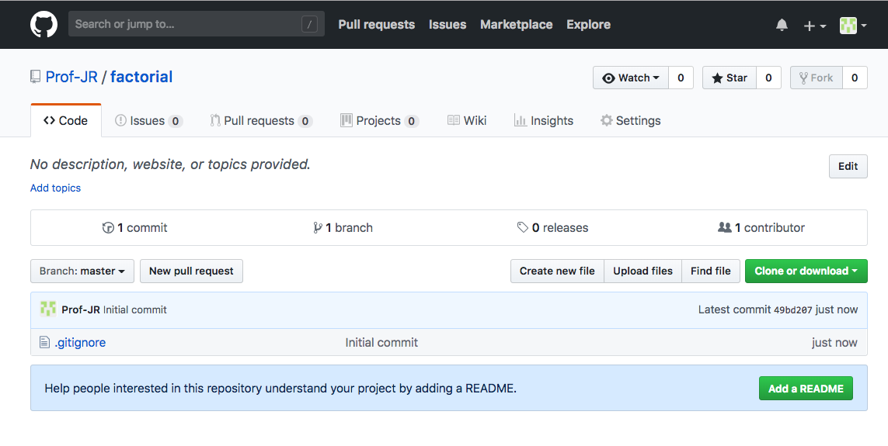
Create a new Repository (github.com)
A new, empty repository
You can also create new repositories in GitHub Desktop

Slide 32
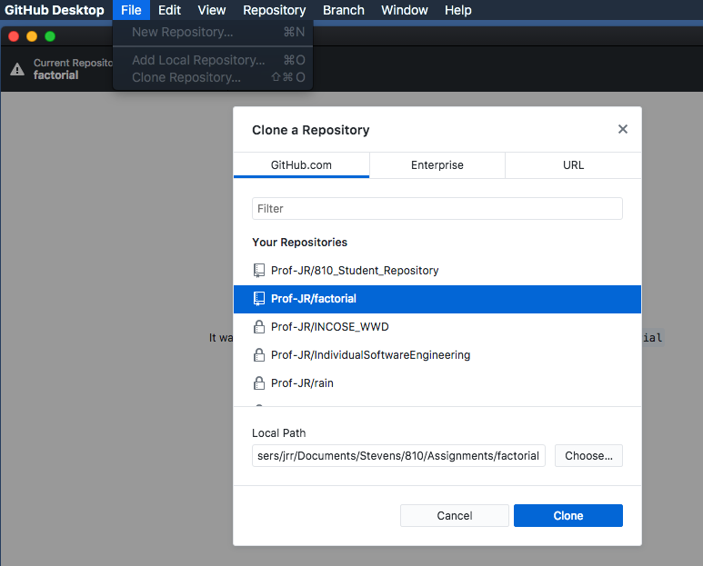
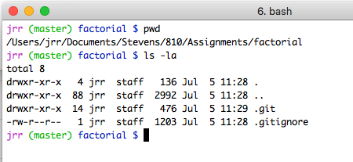
Create local clone of the remote (GitHub Desktop)
Use GitHub Desktop app to clone the new repository to your laptop
The ‘factorial’ repository hosted on github.com
The local repository resides in the .git directory on your laptop
Choose the working directory to store the local repository

Slide 33
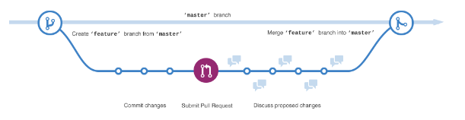
GitHub Branches
Branches allow you to make and test changes to the repository
Master branch is the “official” production version
The Master branch is the version deployed to customer
Feature branches allow experimenting with changes
Feature branches are safe sandboxes where you develop and test code
Source: https://guides.github.com/activities/hello-world/

Slide 34
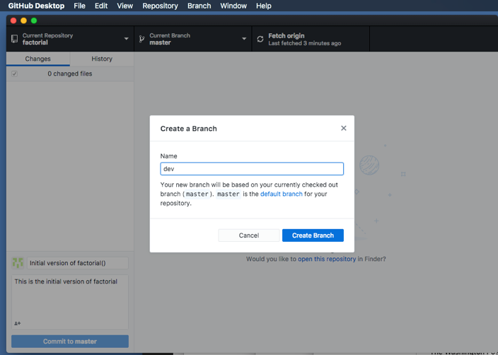
Git Branches
Branches allow for independent development paths
Create a new branch, e.g. dev where we’ll add new features
Choose ‘New Branch…”
You can also create new branches on github.com

Slide 35
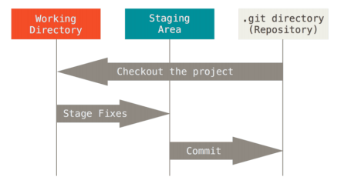
Git’s three states for files
Files are in one of three states
Modified – changed locally, but not committed to the git repository
Staged – marked as ready to be committed to the git repository
Committed – safely stored in the repository
Modified
Committed
Staged
Source: https://progit2.s3.amazonaws.com/en/2016-03-22-f3531/progit-en.1084.pdf

Slide 36
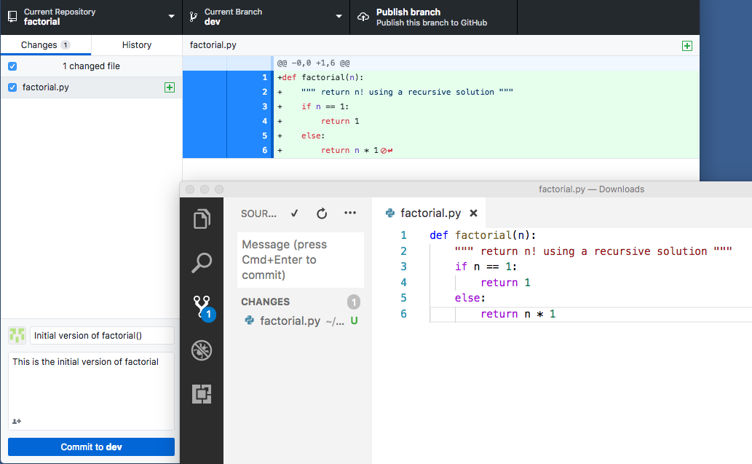
Add a file to Working Directory
Ready to publish new branch to remote repository after commit
Working in the ‘dev’ branch
VS Code, but you can use any tool to create/changes files
VS Code plugins support git
Added a file to the Working Directory, Git detects the change, GitHub Desktop displays the changes

Slide 37
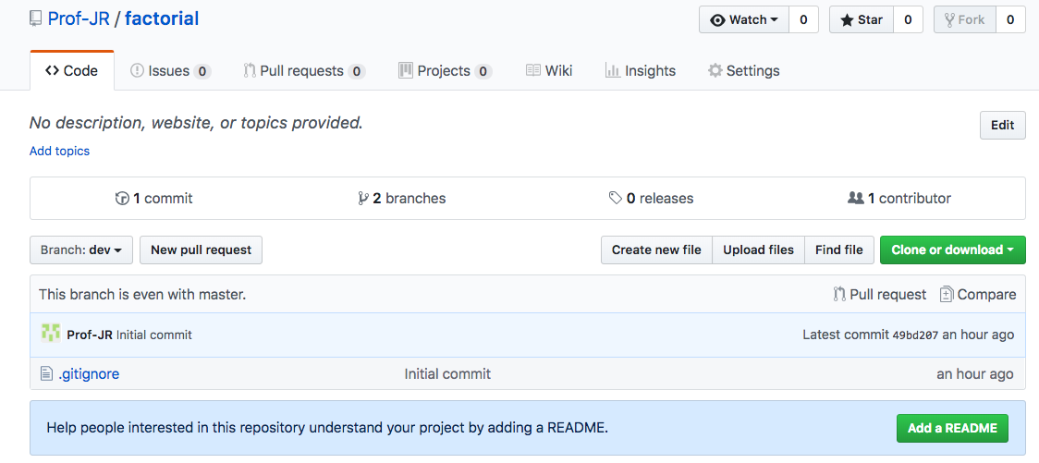
Added a file to local working directory but remote isn’t aware yet…
We created the new branch locally and published the new branch to the remote repository
The remote repository isn’t aware yet of the new file in the local repository

Slide 38
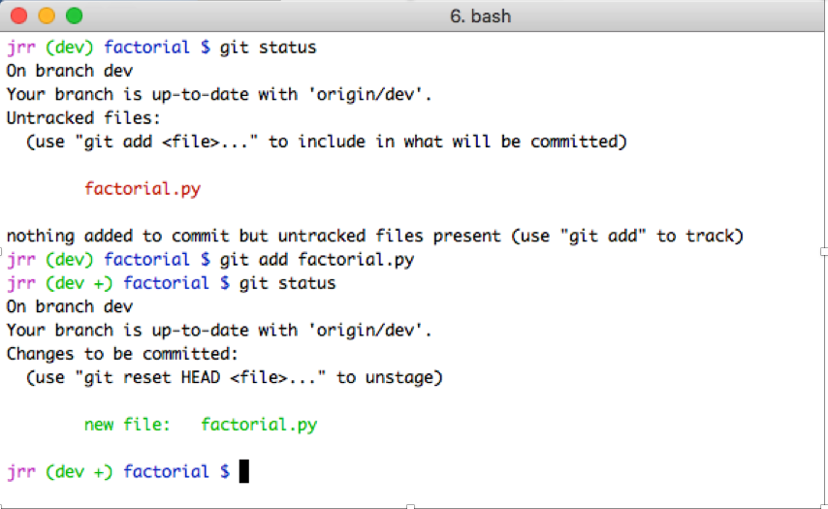
git status, git add
git status detects a new file in the Working Directory
Add the new file to the Staging Area, ready to commit
The new file has not been committed yet

Slide 39
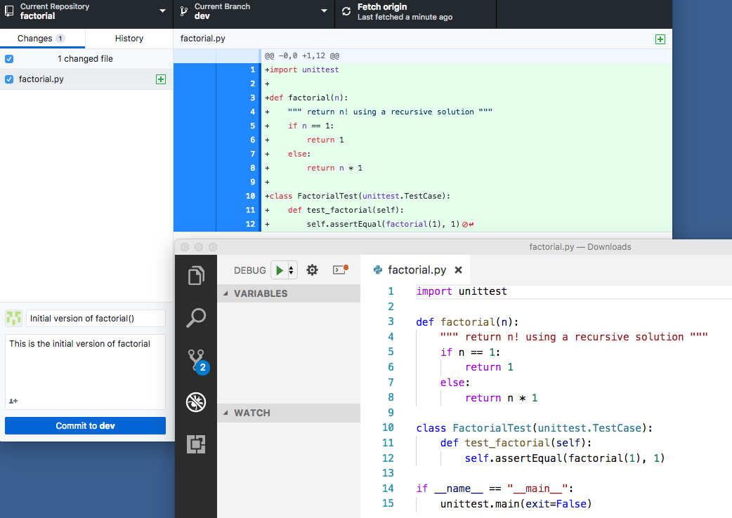
Continue changing the file
Added automated tests
All tests pass
Feature is ready to commit
Git tracks all changes
VS Code, but you may use any tool

Slide 40
Commit
A unit of work, i.e. a collection of related changes
May involve one or more files, but should represent a logical unit of functionality
Should always include a meaningful comment that is helpful to anyone reading the code
Changes should committed frequently to a branch, but not until the feature is complete
Doing a commit may trigger continuous integration and automated testing

Slide 41
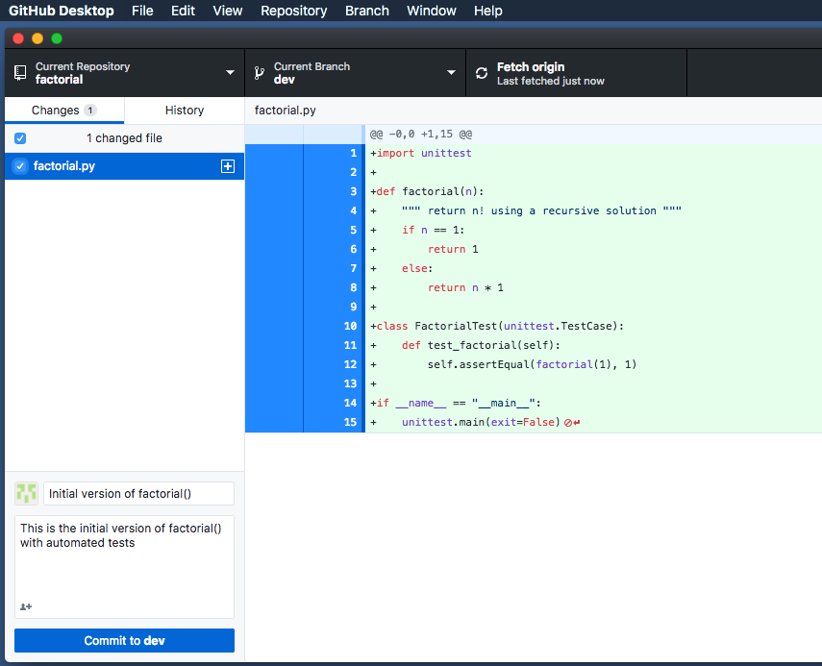
Committing the change
Changes to the file to be committed
Select one or more files to commit with the feature
Brief description of the commit
More details about the feature/change being committed

Slide 42
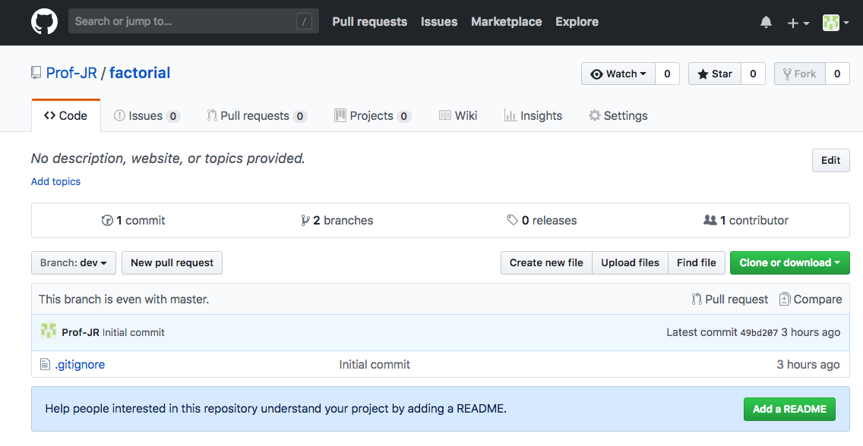
Local commit doesn’t change remote until push
The commit for factorial() to the local repository is not reflected in the remote repository yet…

Slide 43
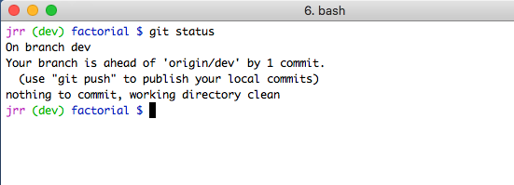
git status after commit
The local dev branch is ahead of the remote repository by one commit. We need to choose when to update the remote repository.

Slide 44
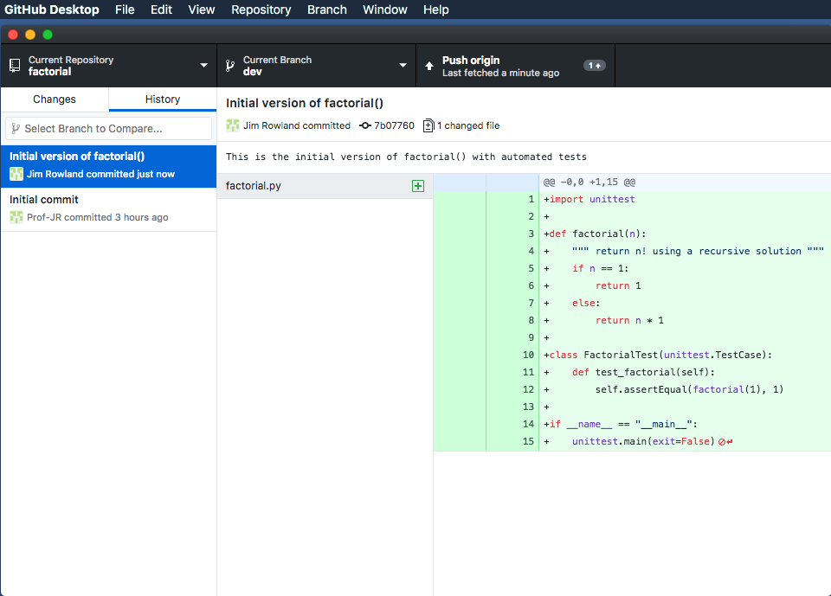
Push the local changes to the remote
“Push origin” pushes the commits from the local repository to the remote repository and merges the changes
Good idea to check changes on remote
before push

Slide 45
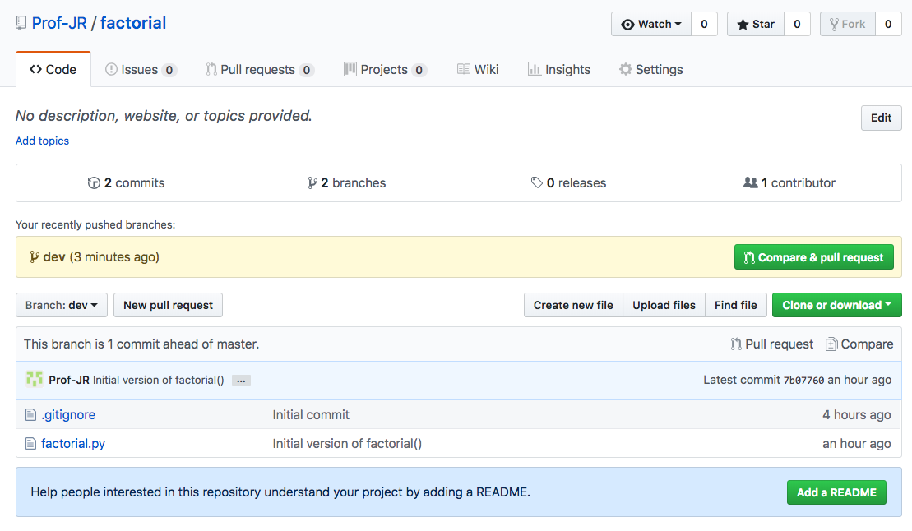
The changes are now on the remote
New factorial.py is now available to everyone from the remote repository on github.com

Slide 46
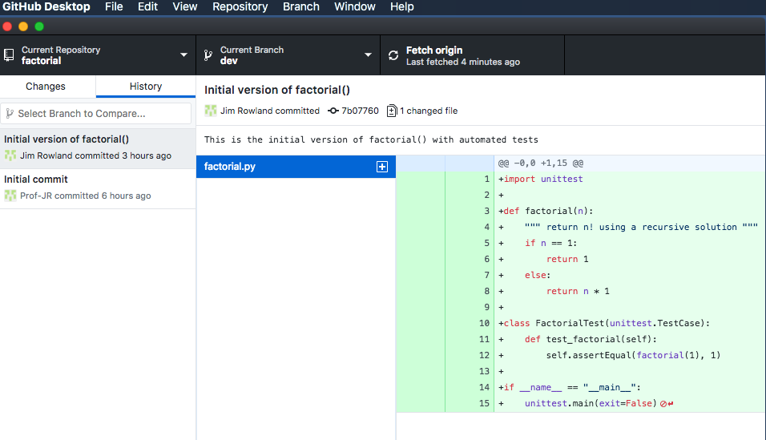
Remote change to factorial.py
Files may be added or changed by other team members
Git helps to manage changes from many contributors
Our factorial.py commit has a unique id and is available to all after push

Slide 47
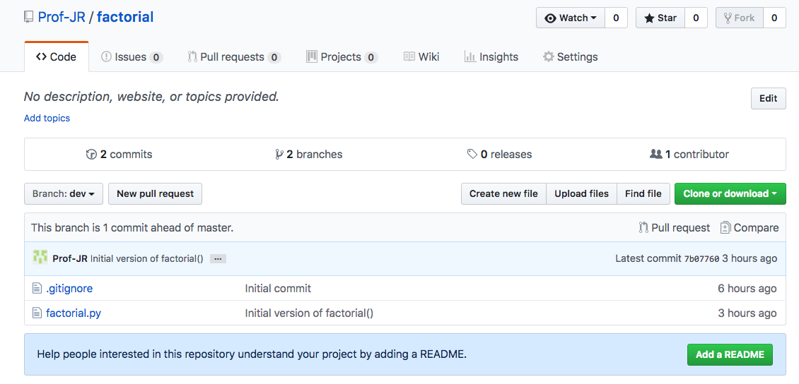
GitHub repository home
The repository page show all directories and files in the project
Create, read, update files in the project from github.com
factorial.py is now available from the remote repository on github.com
Click to see/edit a file from github.com

Slide 48
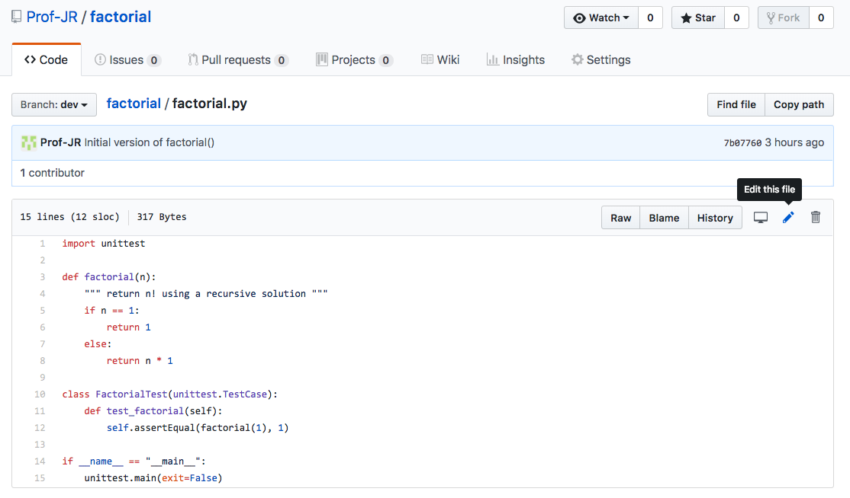
Edit files from github.com
Edit files and commit changes directly from github.com
factorial.py is now available from the remote repository on github.com
Need to fix the bug in factorial.py and add new test cases

Slide 49
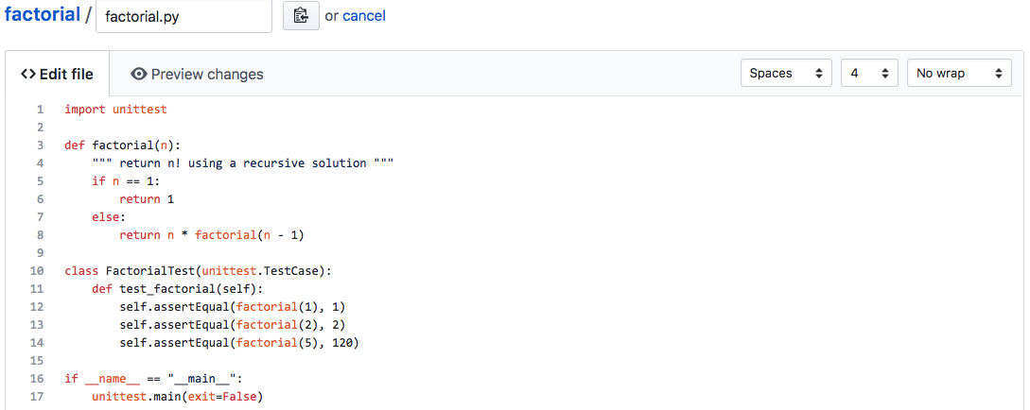
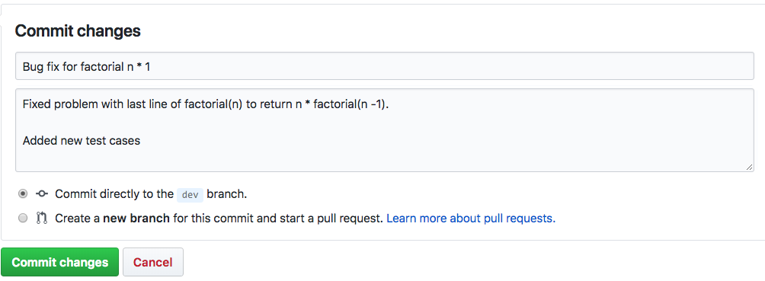
Edit files from github.com
After changing the file on github.com, commit the change

Slide 50
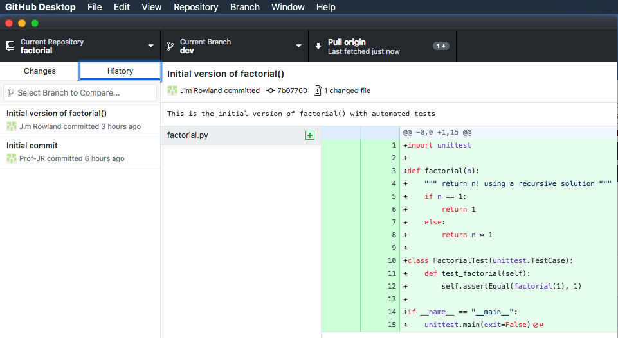
Pull remote changes back to local
Someone updated factorial.py to fix problem
GitHub Desktop detected the change
Pull the changes from remote to update the local repository
Need to pull to update the local repository which is behind by one commit
factorial.py is now available from the remote repository on github.com

Slide 51
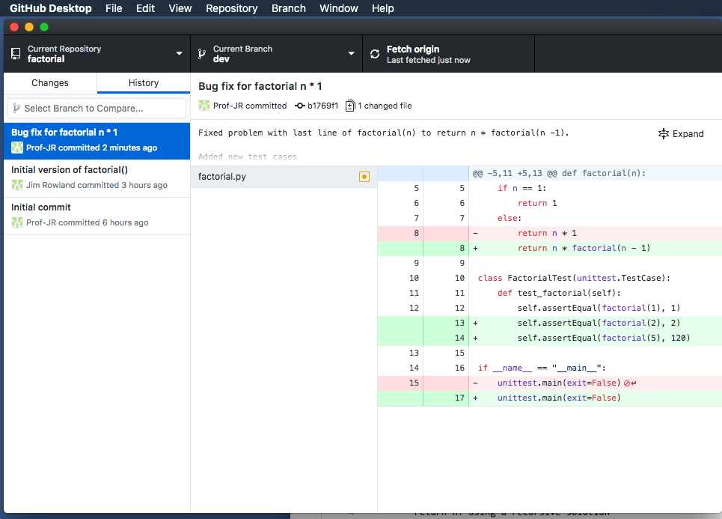
After pull, review the changes
Pulling from the remote updates the local repository to include the latest commits
Compare old and new versions to understand what changed
Pink shows the old lines before the latest commit. New lines are in green.

Slide 52
Pull requests
GitHub supports geographically dispersed teams working on open source projects
Commits may be made by potentially “untrusted” sources
A pull request informs the project leader that changes are available for review and encourages discussion about the changes
Project leader pulls all relevant changes together and chooses which changes to merge into a current or new branch

Slide 53
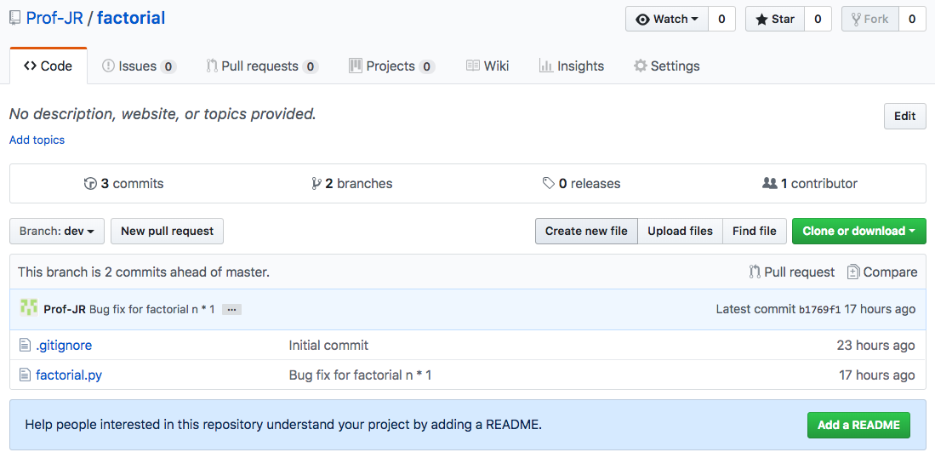
New Pull Request
Initiate a pull request to pull the changes from ‘dev’ into ‘master’
You should be sure to test your system before merging the pull request into the Master Branch
Initiate a pull request

Slide 54
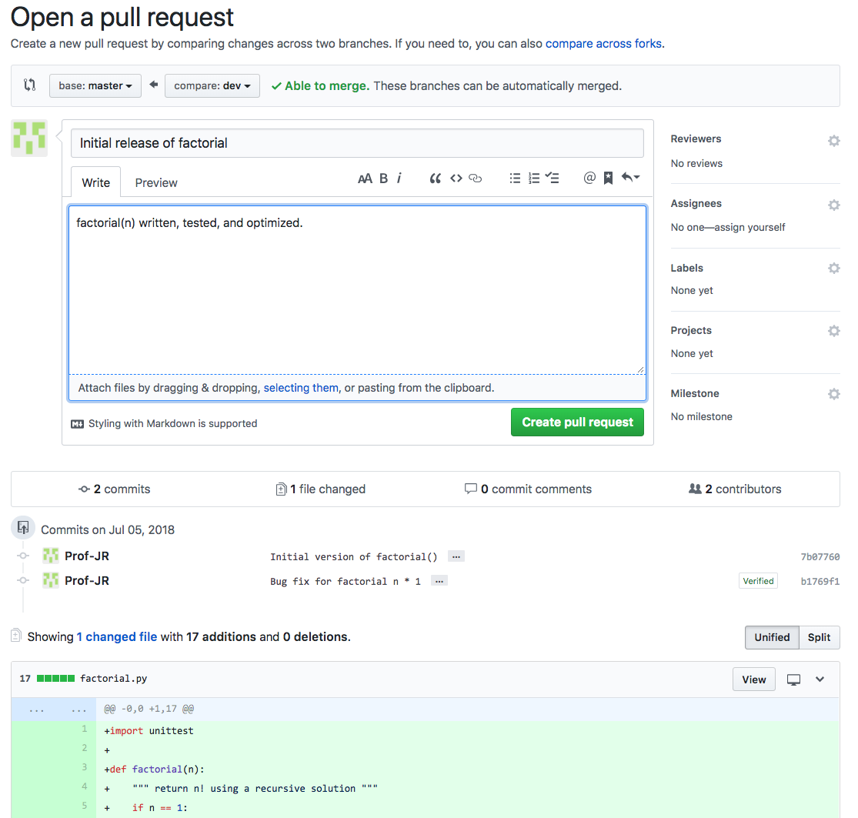
New Pull Request
Document the features
Click when ready
Review changes

Slide 55
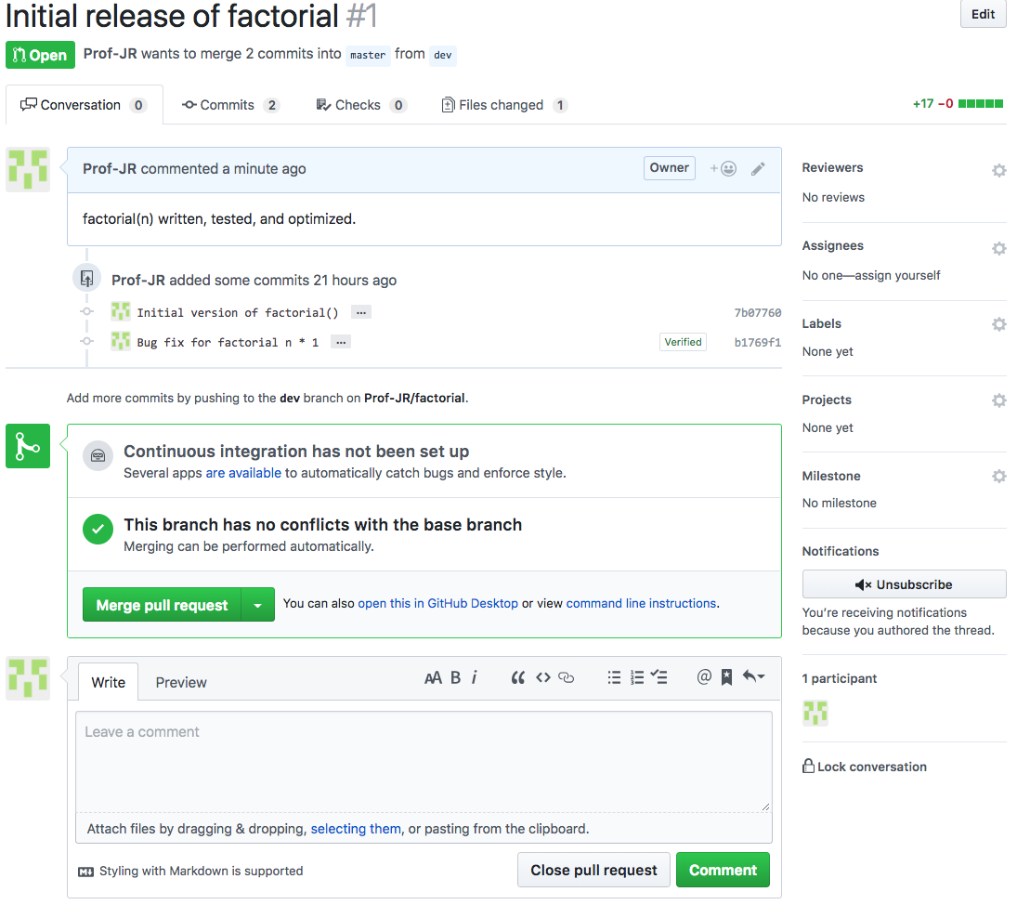
New Pull Request
Review the commits in the release
Continuous Integration causes automated tests to run on every commit – highly recommended!
Merge changes from ‘dev’ into ‘master’

Slide 56
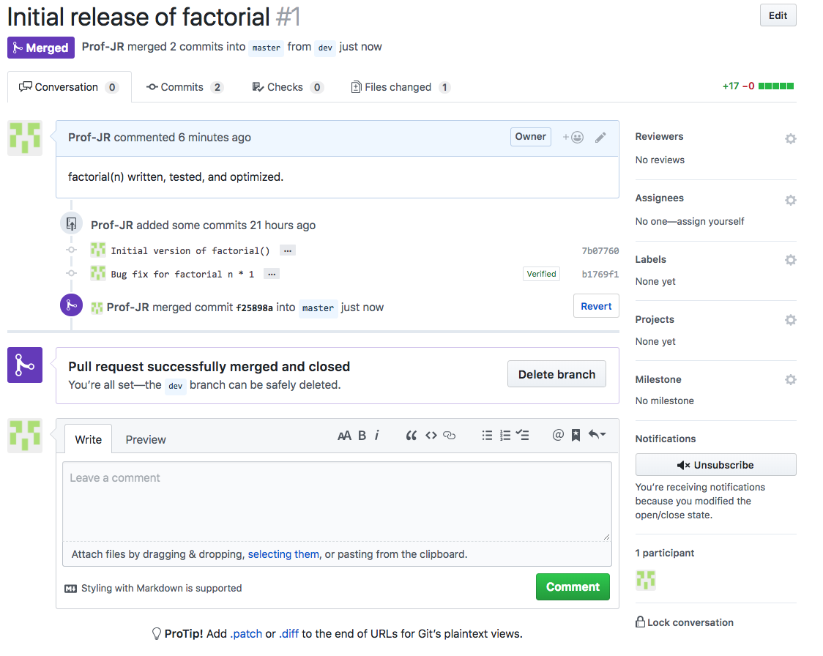
New Pull Request
Review the commits in the release
Pull request merged and closed. You may choose to delete the obsolete ‘dev’ branch
Merge changes from ‘dev’ into ‘master’

Slide 57
Pull requests
Pull requests allow everyone on the team to review changes before the changes are merged into the Master Branch
You are asking the team to pull your changes into the Master Branch
GitHub provides a collaborative environment to allow teams to work together in the same room or geographically dispersed.

Slide 58
Review…
Walk through a common scenario…
Create a remote repository for a new project on github.com
Clone the remote repository to a local repository
Create a new ‘dev’ branch
Create a new file in the local repository
Commit changes locally
Push changes to the remote repository
Change the file in the remote repository
Pull the changes from the remote repository
Merge ‘dev’ and ‘master’ branch

Slide 59
git commands
init
Initialize a new repository
diff*
Compare working directory to repository
Add a tag/label to a branch
log
Push a repository to remote server
add
Mark a file ready for commit
commit
Commit changes to the repository
status*
See the status of all files in the repository
push
See changes made to the repository
branch
tag
Create a new branch
checkout
Switch to a different branch
clone
Clone an existing repository
fetch
pull
retrieve remote changes, but don’t change local
retrieve and merge remote changes locally

Slide 60
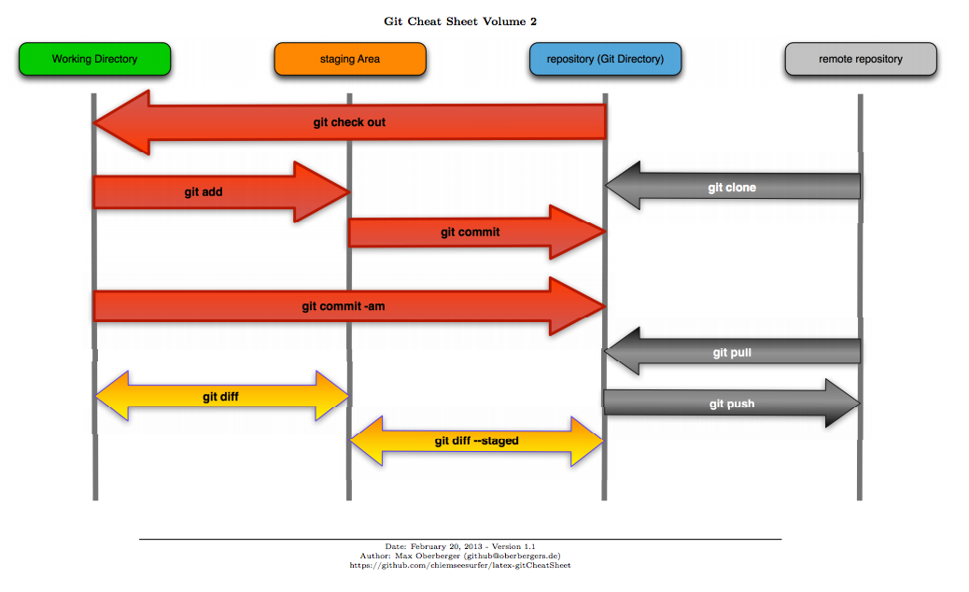
git Cheat Sheet
Source: https://progit2.s3.amazonaws.com/en/2016-03-22-f3531/progit-en.1084.pdf

Slide 61
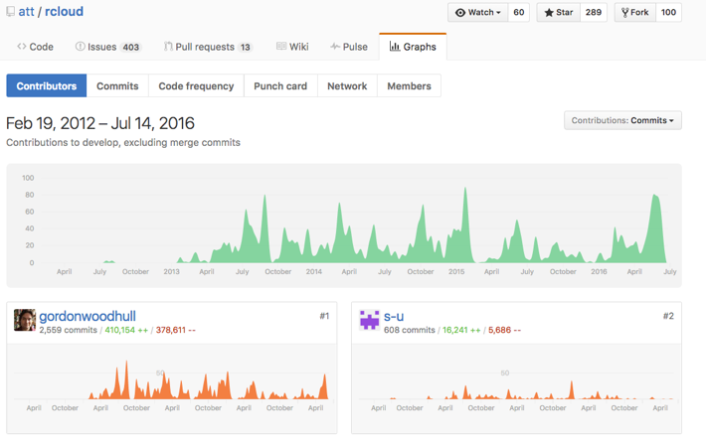
More GitHub features
GitHub offers other useful features
Issue tracking – Create and track project features and issues
Wiki – Describe and discuss the project
Pulse – Show recent activity
Graphs – See who’s doing what

Slide 62
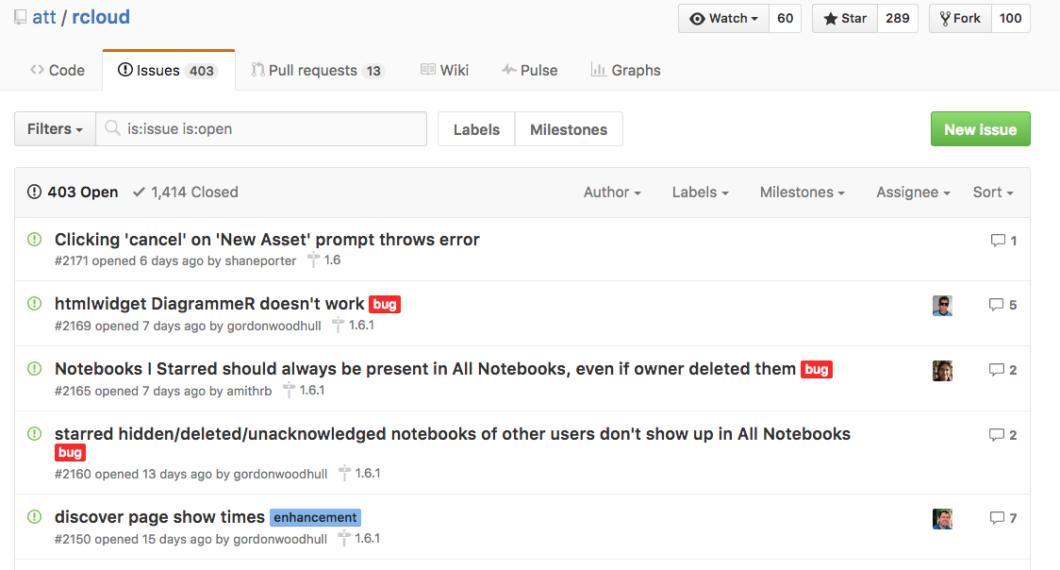
Issues

Slide 63
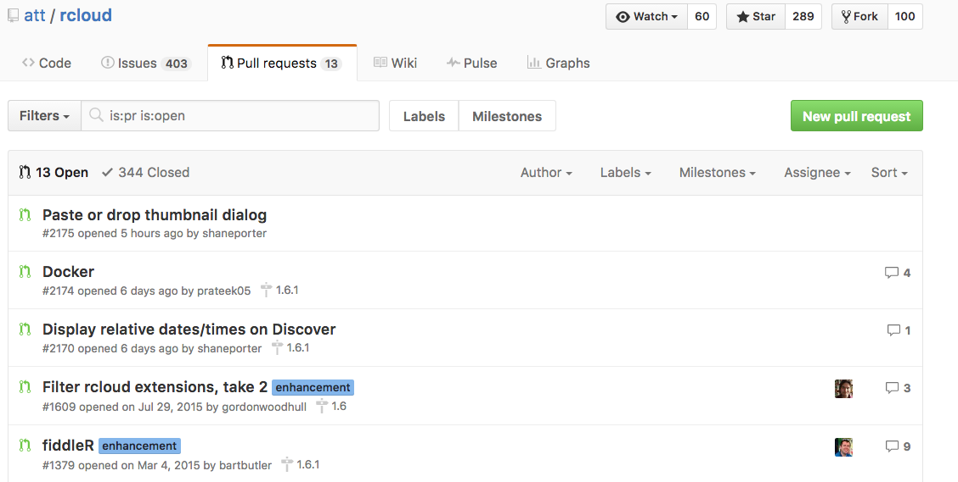
Pull Requests

Slide 64
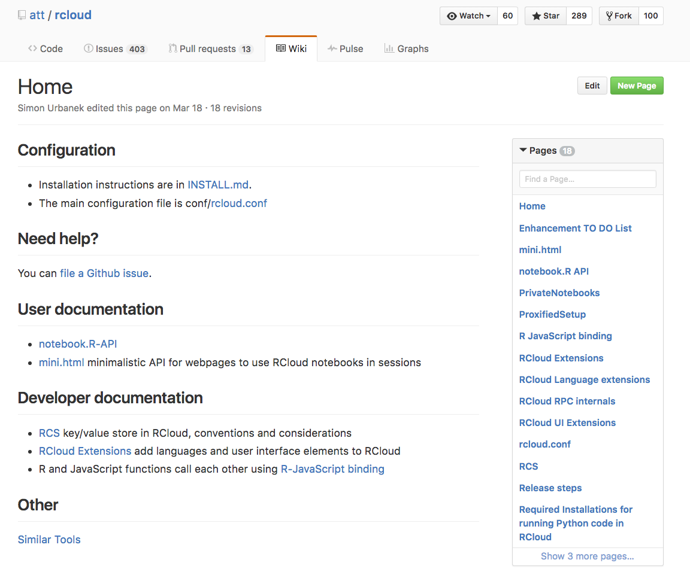
Wiki

Slide 65
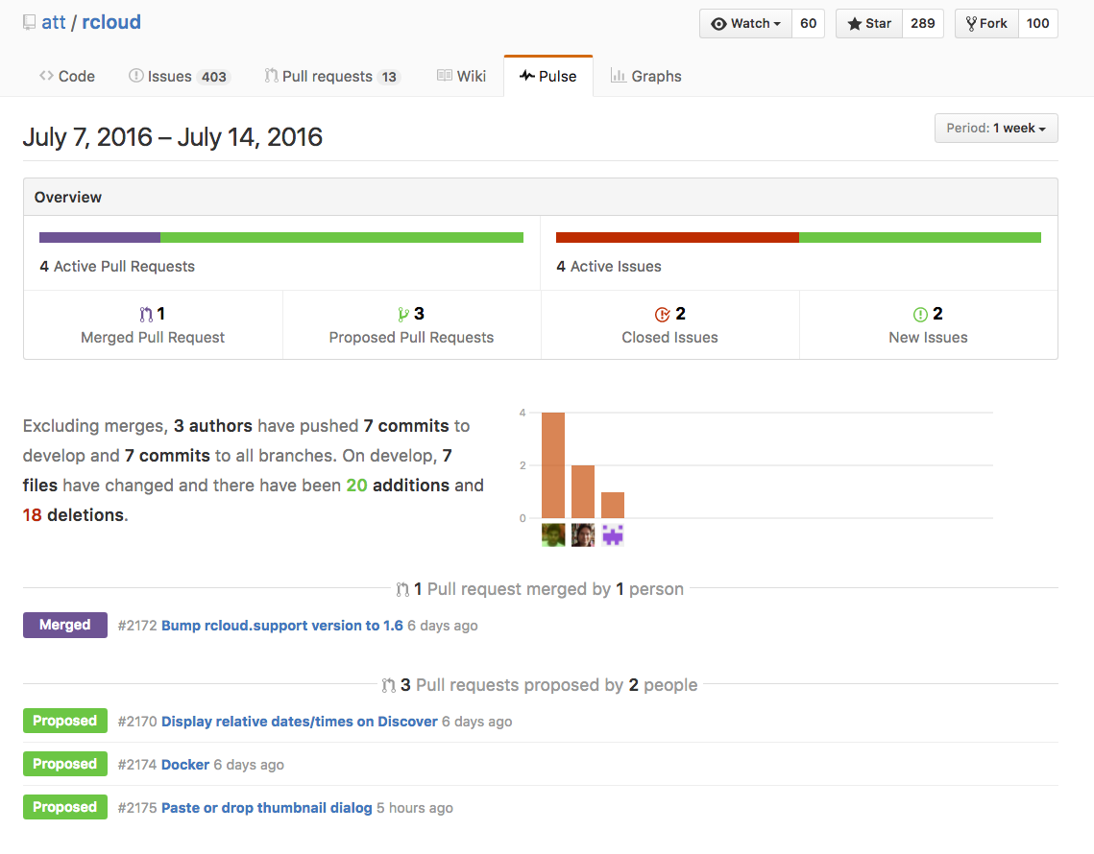
Pulse

Slide 66

Graphs

Slide 67
What to store in GitHub?
All important project artifacts
Source files
Documents
Test cases
Test results
…

Slide 68
Resources
Pro Git : Chacon and Straub
https://progit2.s3.amazonaws.com/en/2016-03-22-f3531/progit-en.1084.pdf
Getting started with GitHub
https://guides.github.com/activities/hello-world/
https://guides.github.com/
https://www.git-tower.com/learn/

Slide 69
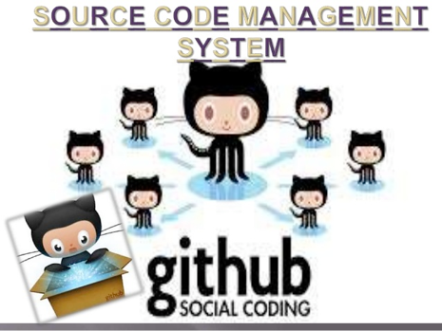
To Do
Register for a free GitHub account at www.github.com
Work through the README tutorial at https://guides.github.com/activities/hello-world/
Start using git or GitHub for your homework assignments
The remainder of the assignments are related and build on the assignments from earlier weeks

Slide 70

Questions?

Slide 71

Week 9 topics
Decorators
Encapsulation
@property, @attribute.setter
Polymorphism
Dynamic typing with Duck Typing
Class attributes
Static methods

Slide 72
Decorators
Decorators allow us to extend the behavior of a function without modifying the function
Wrapping extra functionality before and after a function
Examples:
Time a function call
Track how many times a function is called
Memoize a function to use previous results
Mock a function call while testing
Web frameworks, e.g. Flask
https://wiki.python.org/moin/PythonDecoratorLibrary

Slide 73
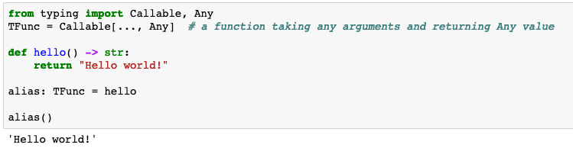
Python functions are first-class objects
Advanced/Optional
Functions can be assigned to variables and passed as arguments to other functions
alias is another name for hello

Slide 74
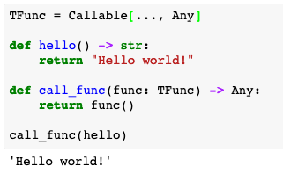
Python functions are first-class objects
Advanced/Optional
Functions can be assigned to variables and passed as arguments to other functions
Call the function passed to call_func
Pass function hello to call_func as an argument

Slide 75
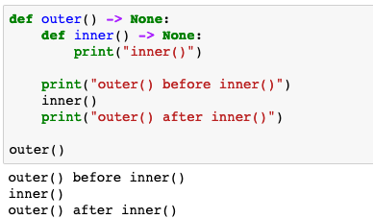
Nested functions
Advanced/Optional
Functions can be nested inside other functions
inner() is visible within outer()
inner() is visible only within outer()

Slide 76
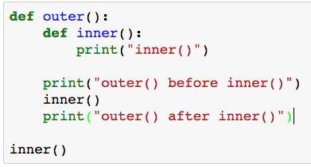
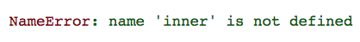
Nested functions
Advanced/Optional
Nested functions are visible only inside the nesting function
inner() is visible only within outer()

Slide 77
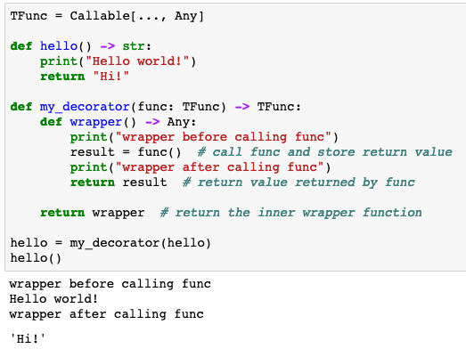
Decorators: Wrapping functions
Advanced/Optional
arbitrary function
Decorator returns the inner wrapper function
hello is now the decorated hello so calling hello() calls my_decorator() and that calls the original hello()
Value returned from decorated hello()

Slide 78
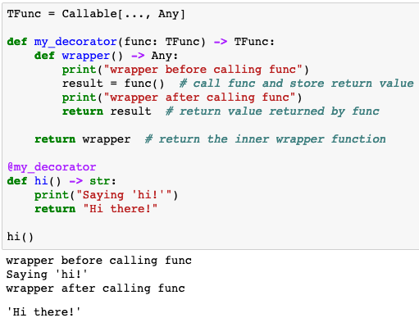
@decorator syntax
Advanced/Optional
Syntactic shortcut for
hi = my_decorator(hi)
Now we can call the decorated hi() which calls the original hi() function

Slide 79
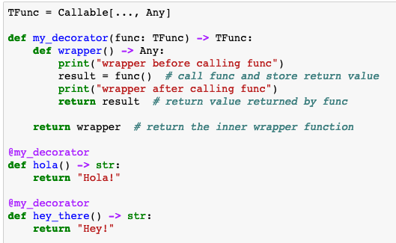
One decorator, many functions
Advanced/Optional
We can apply the same decorator to many functions
Decorate many functions with the same decorator

Slide 80
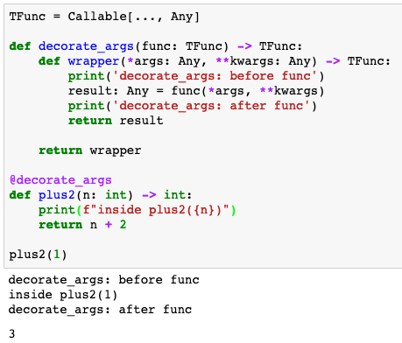
Decorating functions with arguments
Advanced/Optional
wrapper() accepts any number of args and keyword args
Call func with args and kwargs
Return the result of calling func from wrapper

Slide 81

pp_fcall() – see function arguments
Advanced/Optional
print details of arbitrary function call

Slide 82

Execution time decorator
Advanced/Optional
Accept any number/type of arguments
Print function signature, return value, and elapsed time

Slide 83

decorators: execution time
Advanced/Optional
Reuse the timeit decorator for many functions

Slide 84

decorators: execution time
Advanced/Optional
@timeit helps with performance analysis

Slide 85

decorators: logging function calls
Advanced/Optional
@log_calls helps with tracking function calls

Slide 86
Decorators summary
Decorators allow us to extend the behavior of a function without modifying the function
Wrapping extra functionality before and after a function
@foo
def bar(): …
https://wiki.python.org/moin/PythonDecoratorLibrary
I won’t ask you to write a decorator but I do want you to understand what’s happening when you see one

Slide 87
Questions?

